Slide 1
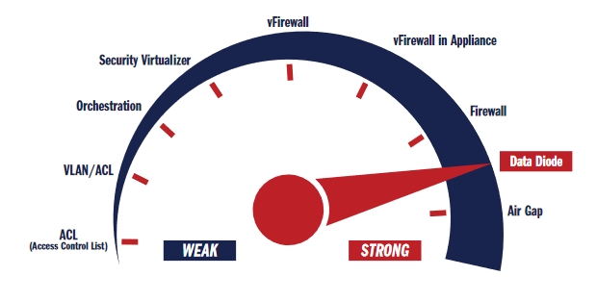
Data Diode
Aman Ranjan Verma
Anand Kumar Jha
Megha Sharma
S. Pravin
Sumit Bothra
Under the guidance of:
Harish Reddy
Image Source: owlcyberdefense-ebook_the-definitive-guide-to-data-diode-technologies.pdf

Slide 2
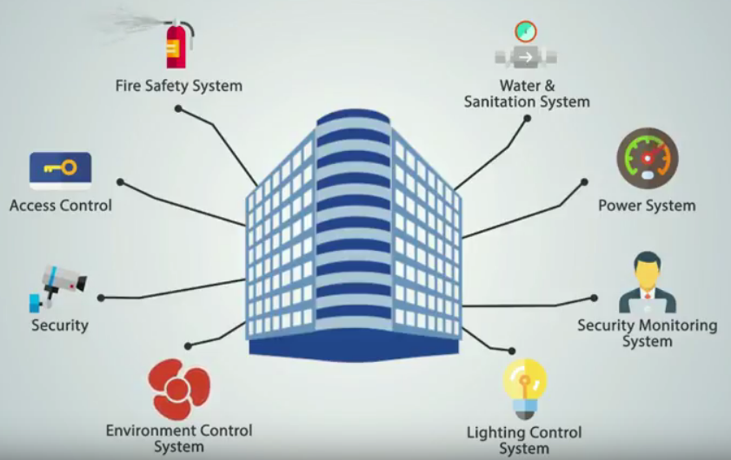
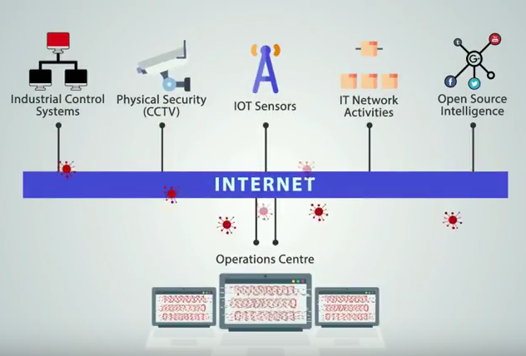
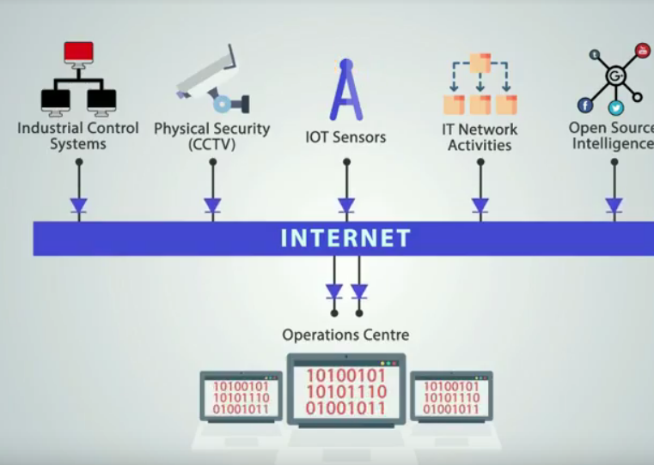
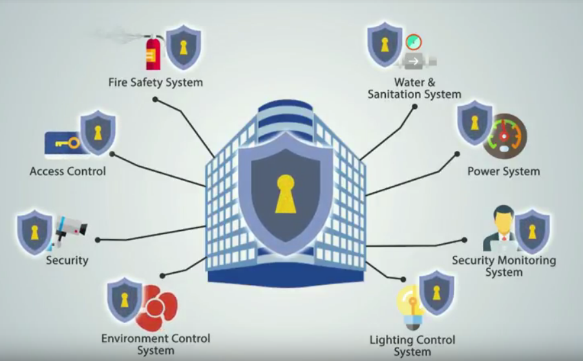
Problem Description
Complexity and frequency of cyber attacks against plant control systems is rising, as is the corporate demand for real time access to plant control system data.
Supervisory Control and Data Acquisition/Industrial Control Systems (SCADA/ICS) perform an essential role in ensuring the safe, reliable operation of critical infrastructure.
High availability requirements and often safety related functionality demand that these systems be protected against deliberate and inadvertent incidents which could compromise their operation.
Image Source: https://www.youtube.com/watch?v=qtWYVihHz5w

Slide 3
Traditional Solutions To The Problem :
A study performed by the Centre for the Protection of National Infrastructure (CPNI) identified that when connecting control systems to external networks, only a small number of architectures are typically used, these range from hosts with dual network interface cards to multi-tiered combinations of switches and routers.
The study concluded however, that the most secure, manageable and scalable segregation architectures were those based on a three zone system such as a De-Militarised Zone (DMZ).
A DMZ provides a means of protecting two networks from each other whilst still allowing for the sharing of data or resources. Creating a DMZ involves placing a firewall offering three or more interfaces, or a pair of firewalls between the plant system and the external network.

Slide 4
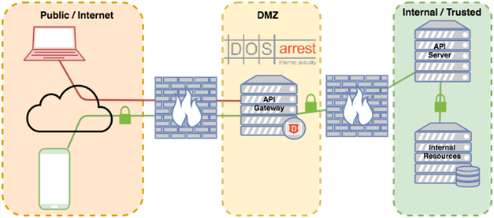
DMZ(De-Militarised Zone )
https://cdn.ttgtmedia.com/rms/onlineimages/sdn-dmz_network_architecture_mobile.png

Slide 5
Drawbacks of DMZ
The use of a DMZ is not without its drawbacks. Vulnerabilities can exist within the firewalls and the shared systems that could allow an attacker to gain control of the DMZ and launch further attacks against the control system.
These vulnerabilities can arise due to incorrectly configured firewall rule sets, unauthorised administrative access or from errors in the design or implementation of the various components of the DMZ.
Even a properly configured and maintained DMZ is not immune from the possibility of 0-day (previously unknown) exploits that could provide a means of attack.

Slide 6
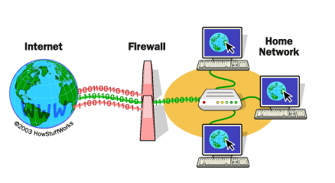
Firewall
At their most basic, firewalls work like a filter between your computer/network and the Internet.
You can program what you want to get out and what you want to get in. Everything else is not allowed.
Drawbacks
It can degrade your system's performance as Packet filtering takes time.
Firewall policies can be very restrictive and can limit users from performing legitimate operations.
Using backdoor exploits limits the firewall's capability to secure your network, as data transmitted through these back doors is not filtered or examined at all.
Image Source: https://www.comodo.com/resources/home/how-firewalls-work.php

Slide 7
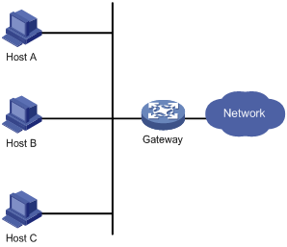
Gateway
A gateway is a node (router) in a computer network, a key stopping point for data on its way to or from other networks. Thanks to gateways, we are able to communicate and send data back and forth.
When a computer-server acts as a gateway, it also operates as a firewall and a proxy server. A firewall keeps out unwanted traffic and outsiders off a private network.
A proxy server is software that "sits" between programs on your computer that you use (such as a Web browser) and a computer server—the computer that serves your network.
Drawbacks
If a gateway fails, then communication will be lost on the network.
Troubleshooting a gateway can be difficult as different tools are necessary for finding problems on computers with different protocols. This communication cannot be restored until the problem is located.

Slide 8
Data Diode Technology

Slide 9
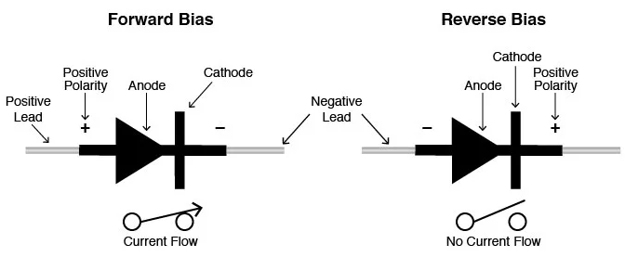
Diode
Diodes are semiconductor devices, in which current flows in only one direction based on biasing voltage applied.
If diodes are forward biased, then they act like a short circuit and allow current to flow through it.
If diodes are reverse biased, then they act like an open circuit and hence no current flows through it.

Slide 10

What is Data Diode?
Data diodes are hardware devices or software that are used to implement unidirectional data transfer between two devices.
In data diodes, there is one device which only sends data to the network and the other device which only receives data through the network.
Data
Send Only
Data
Receive Only

Slide 11
OPTICAL DATA DIODE

Slide 12
OPTICAL DATA DIODE
A data diode is a computer security device that restricts the communication along a network connection between two computers so that data can only be transmitted in one direction.
Since the data diode has a single fiber-optic cable, it is impossible to reverse transmissions due to the basic laws of physics
Requirements:
Three fibre optic transceivers
Two Ethernet cards
Power supply
fibre optic and copper cable
https://www.researchgate.net/publication/267954959_An_Implementation_of_an_Optical_Data_Diode [accessed Jul 17 2018].

Slide 13
Optical Data Diode(Conti…)
Three fibre optic transceivers, the third fibre optic transceiver is required simply to supply a carrier signal to the lower side transceiver which will not work if it does not see the appropriate carrier signal.
Two ethernet cards. One ethernet card is put in each of the gateway work stations so that the two workstations are linked by a dedicated sub-network in order to avoid the possibility of packet collision with other network traffic
A power supply for the third fibre optic transceiver. The power for this could be tapped from the cable that connects the other fibre optic transceiver to the low side ethernet card, if this card can supply enough power for two cards.
Appropriate fibre optic and copper cable to make connections as in next figure.
https://www.researchgate.net/publication/267954959_An_Implementation_of_an_Optical_Data_Diode [accessed Jul 17 2018].

Slide 14
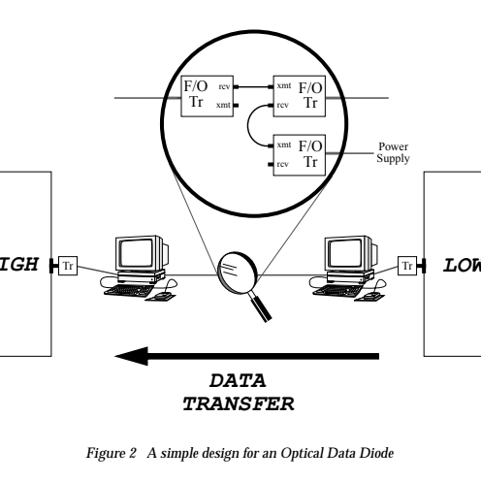
Implementation
Destination
Source
https://www.researchgate.net/publication/267954959_An_Implementation_of_an_Optical_Data_Diode [accessed Jul 17 2018].

Slide 15
Optical Data Diodes(Conti...)
An optical data diode neatly separates into a hardware component and a software component.
The configuration of the hardware is entirely responsible for providing confidentiality security.
The software is responsible for providing the functionality or services through the one way link.
Software like virus checkers can be added to provide integrity protection, although this is not at the same high level of assurance as the confidentiality assurance provided by the optical data diode.
https://www.researchgate.net/publication/267954959_An_Implementation_of_an_Optical_Data_Diode [accessed Jul 17 2018].

Slide 16
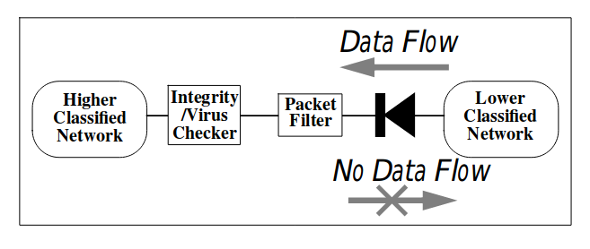
Destination
Source
https://www.researchgate.net/publication/267954959_An_Implementation_of_an_Optical_Data_Diode [accessed Jul 17 2018].

Slide 17
Advantages
The design of the optical data diode is very simple. Assurance that it is prohibiting communication in the reverse direction is confirmed by visual inspection of the configuration.
The simple design should also enable easy accreditation by the local accrediting authority.
Such a data diode can be built easily.
Disadvantages
The main disadvantage of this design is the fact that the delivery of data from the low side to the high side is in theory unreliable.
In practice it can be very reliable but there is no absolute guarantee that delivery will always occur.

Slide 18
Data Diodes using Proxy Servers in Modbus Protocol

Slide 19
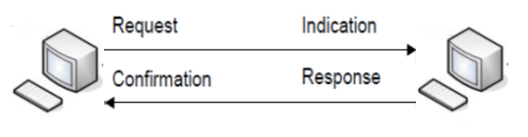
Typical Modbus TCP Communication
The Modbus TCP Communication is based on Client / Server Request-Response Communication
In this Protocol, the Client (MTU) requests for data. Based on the request received by the Server (RTU) , the response is provided to the Client.

Slide 20
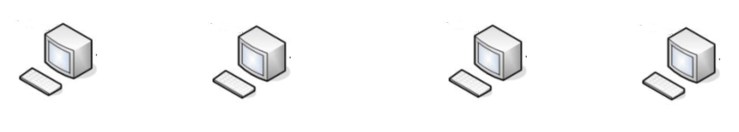
Data Diode Model For Modbus Protocol
Request
Request
Response
Response
RTU
Server
Proxy
Server 1
Proxy
Server 2
MTU
Client

Slide 21
Data Diode Model For Modbus Protocol
The RTU Server and Proxy 1 Server communicates at Modbus Port no 502. The Proxy 1 acts like a Client with respect to RTU and sends request to the RTU. The RTU checks the request, and based on the request, sends a response to the Proxy Server 1.
The Proxy Server 1 acquires the data, the forwards the data to the Proxy Server 2. Here the data transfer is unidirectional and hence the data transfer cannot take place from Proxy Server 2 to Proxy Server 1. Hence the data diode is implemented between Proxy Server 1 and Proxy Server 2. Here is transferred from any port other than 1 to 1023 port.
The MTU requests data from Proxy Server 2 form the same Port 502. Here the proxy acts like the RTU Server and thus provides data to the MTU. The MTU then forwards the data to the database as well as to the HMI.

Slide 22
Data Transfer in Data Diodes
RTU
Proxy 1
Proxy 2
MTU
Request
Request
Response
Response
Response
Port : 502
Port : 4000
Port : 502

Slide 23
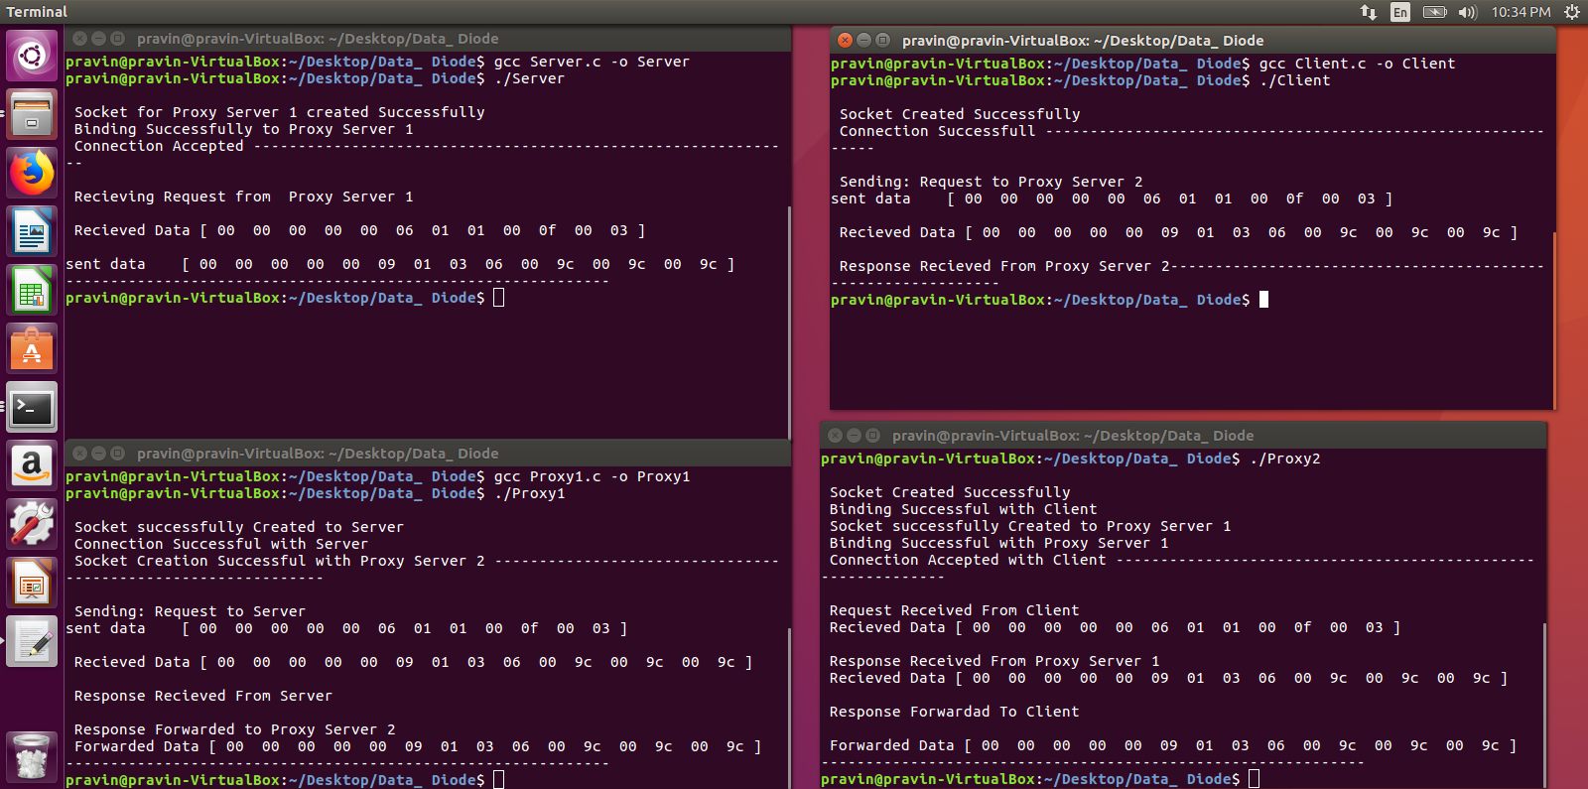
Server
Client
Proxy 1
Proxy 2
Demonstration

Slide 24

For acquiring Different Field Device data
Request
Request
Response
Response
RTU
Server
Proxy
Server 1
Proxy
Server 2
MTU
Client

Slide 25
Advantages of Data Diode
Since the data transfer is unidirectional, it is very much secure and it is very much difficult to conduct an attack at the RTU/Server
It can be applicable on various other protocols and is not only bound to Modbus.
Even if any attack is successfully conducted at the MTU, the attacker cannot perform any attack at the RTU as the Proxies only communicate in unidirectional mode.
Disadvantages
Since the data transfer is unidirectional in nature, actuators cannot be used in the above model. Hence it limits our usage to only to sensors and the control signals cannot be sent through it.
The Data can still be retrieved from Proxy Server 1, but no control commands can be given.

Slide 26
Applications
SCADA System
IoT
In Isolating a Server from the Corporate Network

Slide 27
Data Diode using ATM Protocol

Slide 28
Data Diode using ATM Protocol
Hardware based cyber security(Dual Diode).
Hardware is designed to only be one-way.
Impervious to software changes or attacks.
Either it will work as intended to work or will not work at all.
Deploy non-routable ATM protocol break between the two segmented network.
Server
Client
Send only
Receive only
Source: Owl Cyber Defense

Slide 29
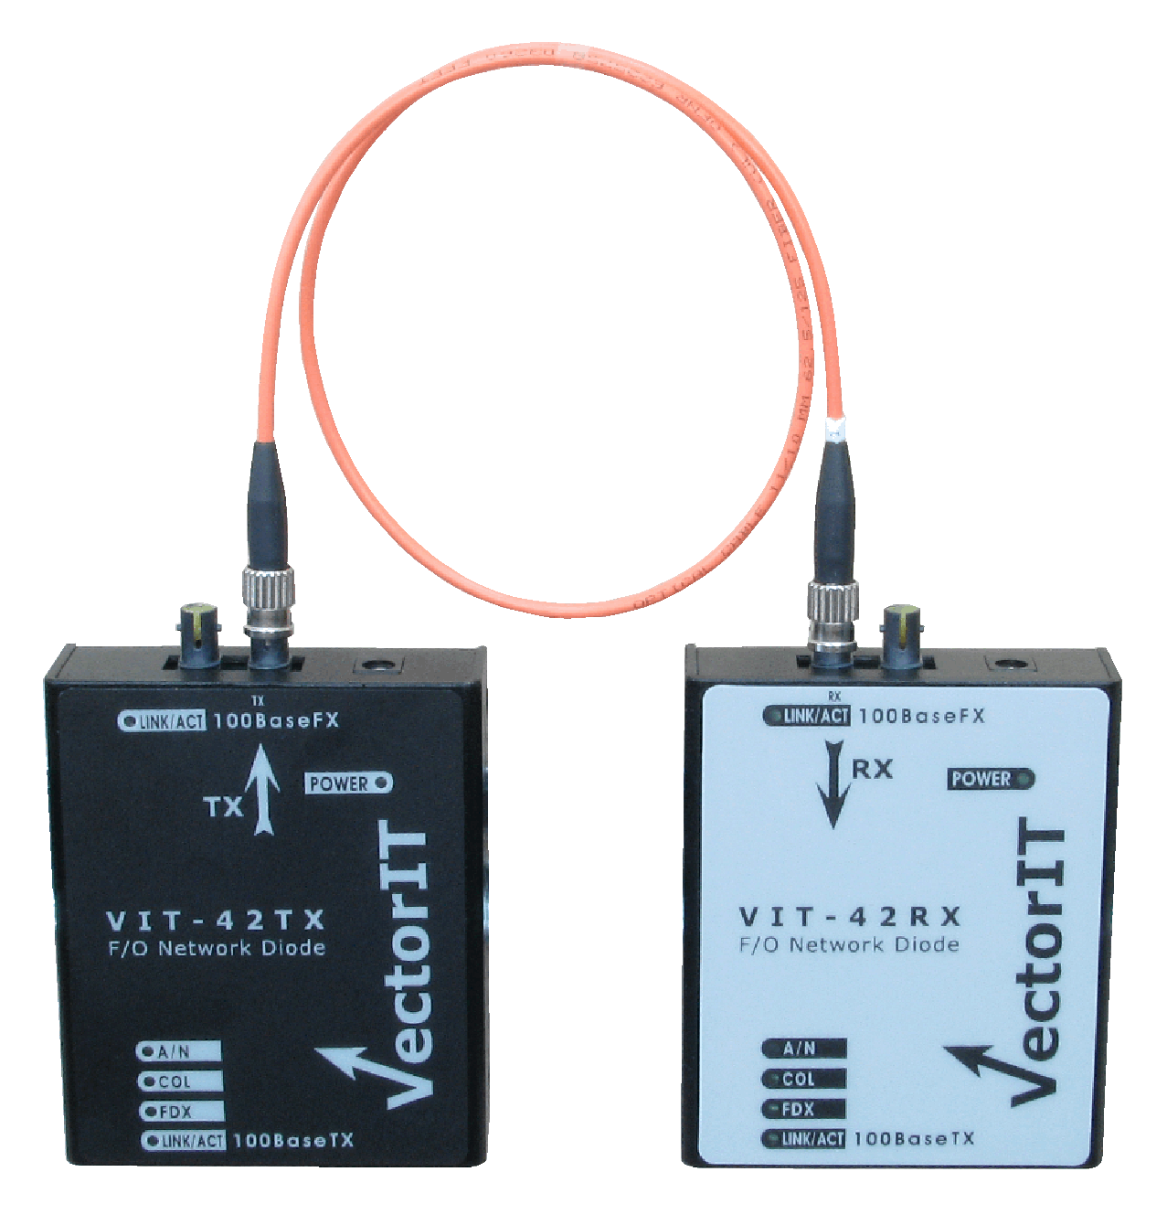
Why ATM(Asynchronous Transfer Mode) ?
It was designed to move large amount of data asynchronously.
Large data rates.
High quality (high bandwidth optical fiber).
No packet loss.
As a result we get quality of service, non routable protocol break which maintains
100% confidentiality and it’s all forced in hardware so it can’t change.
The optic cable doesn’t have any security and if any attacker want to intercept data through cable, ATM protocol doesn’t allow since it doesn’t have the concept of source and destination address.
Source: Owl Cyber Defense

Slide 30
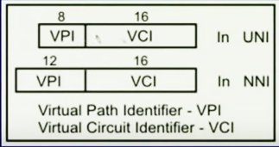
Detailed view
Server
Air Gap
Client
Routing Table
IP Proxy
IP Proxy
Ethernet
ATM transport
Ethernet
Payload of datagrams are embedded into non-routable ATM cell which then is transmitted using ATM channel number. The routing table looks for ATM channel number and decides what to do with the data.
Also in this scenario the inside IP address does not make it to the outside.

Slide 31
About ATM
Driven by the integration of services and performance requirements of both telephony and data networking(IP Based).
Transmit information in small fixed size packets, cells(allowed fast h/w switching)
Cells are transmitted asynchronously.
The Network is connection oriented.(statistical multiplexing)
Each cell is 53 bytes long – 5 bytes header and 48 bytes payload.
ATM is independent of transmission medium. They may be sent on a wire or fiber by themselves or they may also be packaged inside the payload of other carrier systems.
Making an ATM call requires first sending a message to setup a connection. Subsequently all cells follow the same path to the destination.
statistical multiplexing : similar to dynamic bandwidth allocation (DBA)

Slide 32
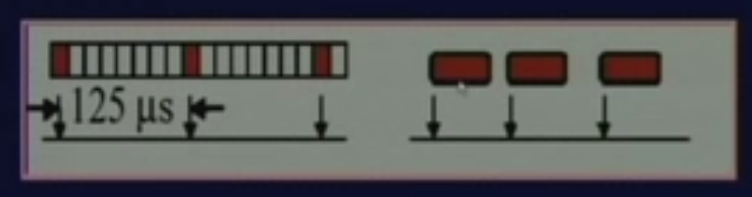
ATM Vs Telephony
Phone networks are synchronous(periodic).
Phone network uses circuit switching whereas ATM network uses “Packet” or “Cell” switching with virtual circuits.
In phone networks, all rates are multiple of 64 kbps. With ATM we can get any rate, and we can vary our rate with time.
Source: https://www.youtube.com/watch?v=IPuLZSOye4c (NPTEL)

Slide 33
ATM Vs Data Networks(IP Based)
ATM cell – Fixed/small Size
IP Packets: Variable size
ATM uses 20 Byte global addresses for signaling and 32-bit locally-assigned labels in cells. Whereas IP uses 32-bit global addresses in all packets.
ATM offers sophisticated traffic management whereas TCP/IP: congestion control is packet loss-based.
Source: https://www.youtube.com/watch?v=IPuLZSOye4c (NPTEL)

Slide 34
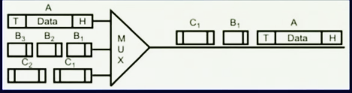
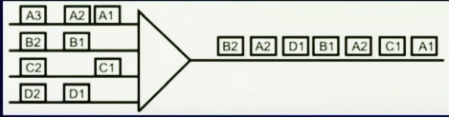
ATM: Fixed size Packets
Simpler Buffer Hardware
Packet arrival and departure requires us to manage fixed buffer sizes.
Simpler scheduling
Each cell takes a constant chunk of bandwidth to transmit.
Drawback: Overhead for sending small amount of data. Segmentation and reassembly cost.

Slide 35
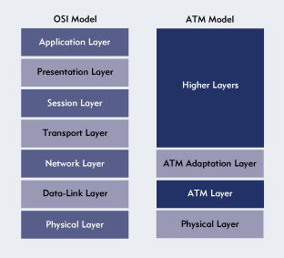
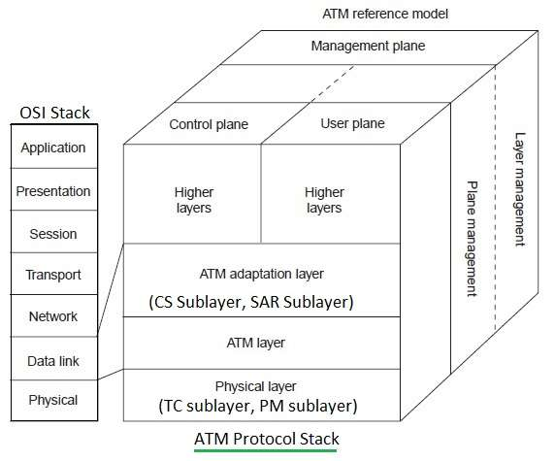
ATM Layer
AAL
Convergence sublayer
SAR: Segmentation and reassembly sublayer
ATM Layer
Performing Routing, Switching,
traffic management, multiplexing
Physical Layer
PMD: Physical Medium Dependent sublayer
Transmission Convergence sublayer
Image Source: http://www.rfwireless-world.com/images/ATM-protocol-stack.jpg

Slide 36
Industries in need of Data Diode as cyber security
Nuclear Power Plant (between process control plant and their outside business network).
Fossil and hydro generation plant.
Oil and Gas companies.
Petrochemical, water management and wastewater.
Mining companies.
Our work is to explain our technology and use cases and see how it can fit into their
architecture.
A fossil fuel power station is a power station which burns a fossil fuel such as coal, natural gas, or petroleum to produce electricity.

Slide 37
Firewall Based Mechanism

Slide 38
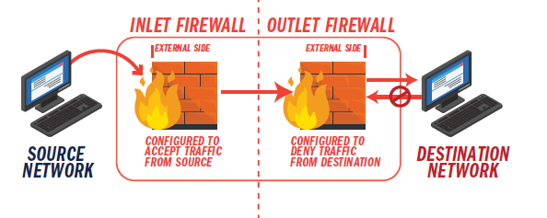
Firewall Based Mechanism
Image Source: owlcyberdefense-ebook_the-definitive-guide-to-data-diode-technologies.pdf

Slide 39
Firewall Based Mechanism (Conti…)
Relies on Software Configuration
They communicate through Ethernet cables.
A pair of firewalls configured back-to-back provide a more secure implementation
Firewall on source side is configured to filter traffic from source side
Firewall on destination side is configured to deny the traffic from destination side.
Prone to Malware attacks due to vulnerabilities of software-based solutions.

Slide 40
Comparative Assessment of Various Data Diode Implementation Techniques
Specifications | Optical Data Diode | Proxy Based Data Diode | ATM Based Data Diode | Firewall Based Mechanism
Connection | One- Way with optical fiber | One-way with proxy servers | One –Way with optical fiber | One-way with Software Configured
Protocol | UDP | MODBUS | ATM | TCP-IP
Routability | Routable | Routable | Non-Routable | Routable
Reliability | Unreliable | Unreliable | Highly Reliable | Reliable
Throughput | Low | Low | High | Moderate
Image Source: owlcyberdefense-ebook_the-definitive-guide-to-data-diode-technologies.pdf

Slide 41
CONCLUSION / WAY FORWARD
Expanding Domain Of Data Diodes in Govt, Military, Critical Infrastructure, Financial Services, Telecommunications.
The Cybersecurity goal of any organization to minimize risks while preserving data availability seems achievable with the advent of ATM Based Data Diode
Advanced Technology will enable network segments to get smaller, providing better security.
As IoT expands, Security becomes prime concern & Data Diodes provide promising solution
The Unhackable nature of Hardware based solutions with new innovations for greater efficiency, flexibility & performance presents a bright future ahead.

Slide 42

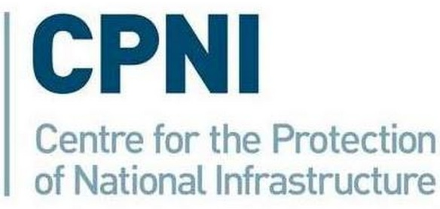


References
owlcyberdefense-ebook_the-definitive-guide-to-data-diode-technologies.pdf
https://www.owlcyberdefense.com/about-data-diodes/
A study of cyber security policy in industrial control system using data diodes, IEEE Paper
https://www.opswat.com/blog/why-data-diodes-are-essential-isolated-and-classified-networks
https://www.baesystems.com/en/product/data-diode-solution
The Technique of Network Diode, IEEE Paper
https://www.advenica.com/en/cds/data-diodes
The application of data diodes for securely connecting nuclear power plant safety systems to the corporate IT network, IEEE Paper
https://en.wikipedia.org/wiki/Unidirectional_network

Slide 43


